Slide 1
Problem Set
Computing BKM(2003) Moments from IVS

Slide 2
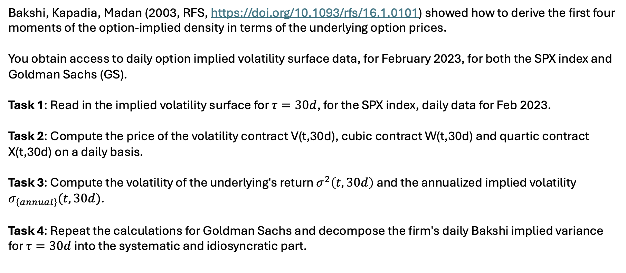
Bakshi, Kapadia, Madan (2003, RFS, https://doi.org/10.1093/rfs/16.1.0101) showed how to derive the first four moments of the option-implied density in terms of the underlying option prices.
You obtain access to daily option implied volatility surface data, for February 2023, for both the SPX index and Goldman Sachs (GS).
Task 1: Read in the implied volatility surface for $τ=30d$, for the SPX index, daily data for Feb 2023.
Task 2: Compute the price of the volatility contract V(t,30d), cubic contract W(t,30d) and quartic contract X(t,30d) on a daily basis.
Task 3: Compute the volatility of the underlying's return $σ^{2}\left(t,30d\right)$ and the annualized implied volatility $σ_{\left\{annual\right\}}(t,30d)$.
Task 4: Repeat the calculations for Goldman Sachs and decompose the firm's daily Bakshi implied variance for $τ=30d$into the systematic and idiosyncratic part.

Slide 3
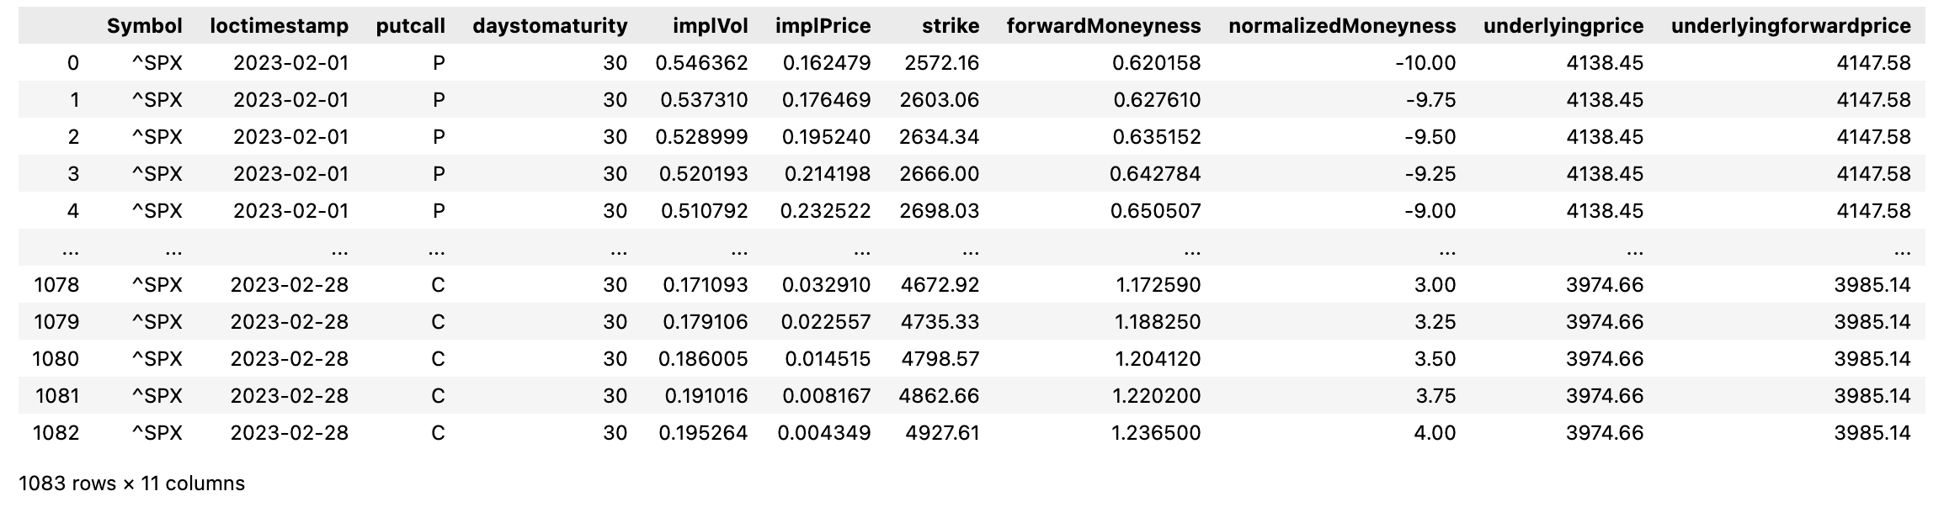

Task 1
Forward moneyness:
$$m_{i,τ}=\frac{K_{i,τ}}{F_{τ}}$$
Normalized moneyness:
$${\overline{m}}_{i,τ}=\frac{ln⁡(m_{i,τ})}{\sqrt{τ} σ_{τ}^{ATM}}$$
Daily data
30dtm
from -10 to +4 stddev for each date-maturity-combination; equally spaced in m_norm in 0.25 increments
Data file holds all daily IVS data for SPX index

Slide 4
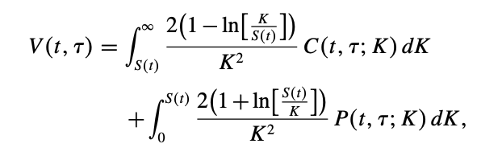
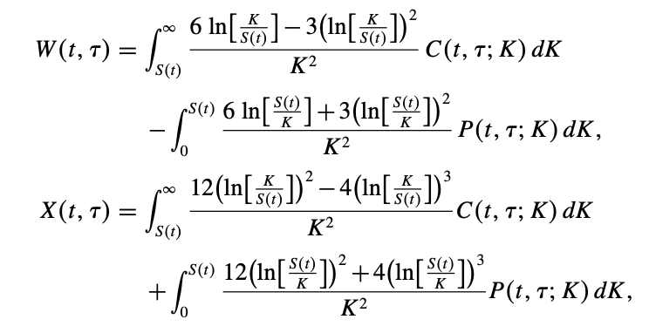
Task 2
Formulas for V,W,X
known from BKM(2003) paper
Integration relies on
Trapezoidal rule
OTM calls and OTM puts
Hint: Identify OTM Puts with (K < S_t)
Based on Bakshi, Kapadia, and Madan (2003), the price of the volatility, cubic, quartic contracts can be computed using an integral that involves the implied option prices and strike prices. To facilitate the computation, we approximate this integral using the trapezoidal rule.

Slide 5
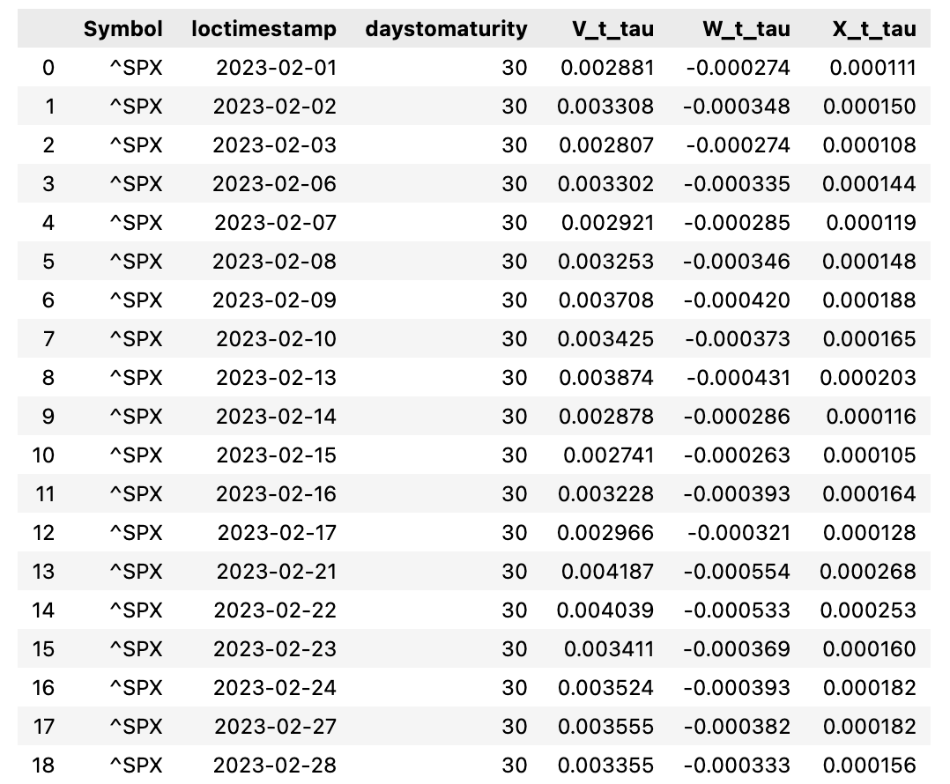
Task 2

Slide 6
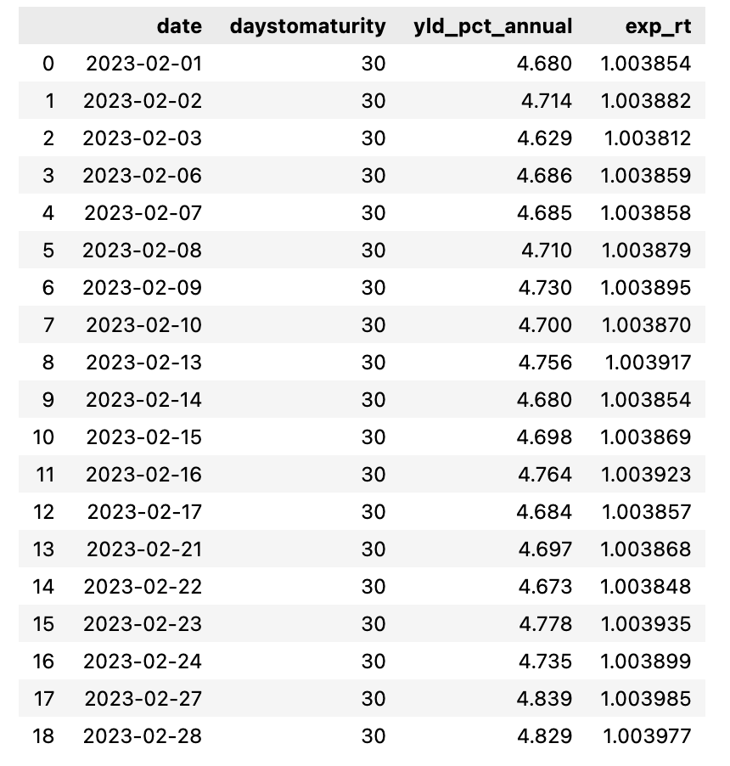
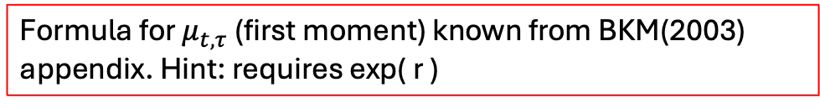
Task 3
Hint: Var(x) = E[x^2] – E^2[x]
Requires calculation of first moment of underlying return
Formula for $μ_{t,τ}$ (first moment) known from BKM(2003) appendix. Hint: requires exp( r )
We have already calculated everything except exp(rt). r is unknown so far. Therefore we load in (option-implied) riskfree yields for the US market, for 30dtm. These yields were computed following the methodology from Ulrich, Zimmer, Merbecks (2023)

Slide 7
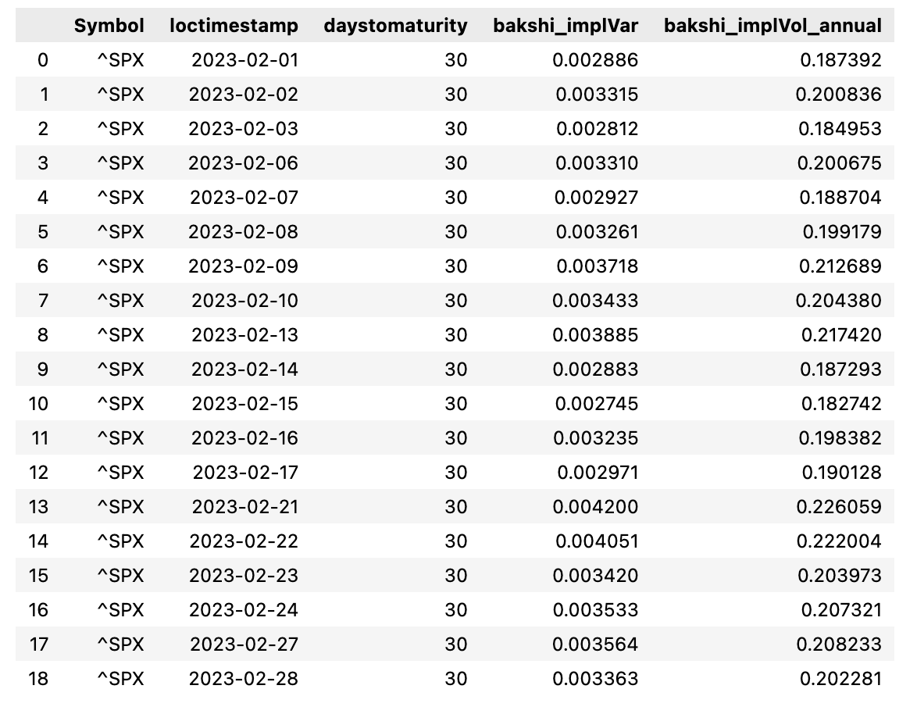
Task 3

Slide 8
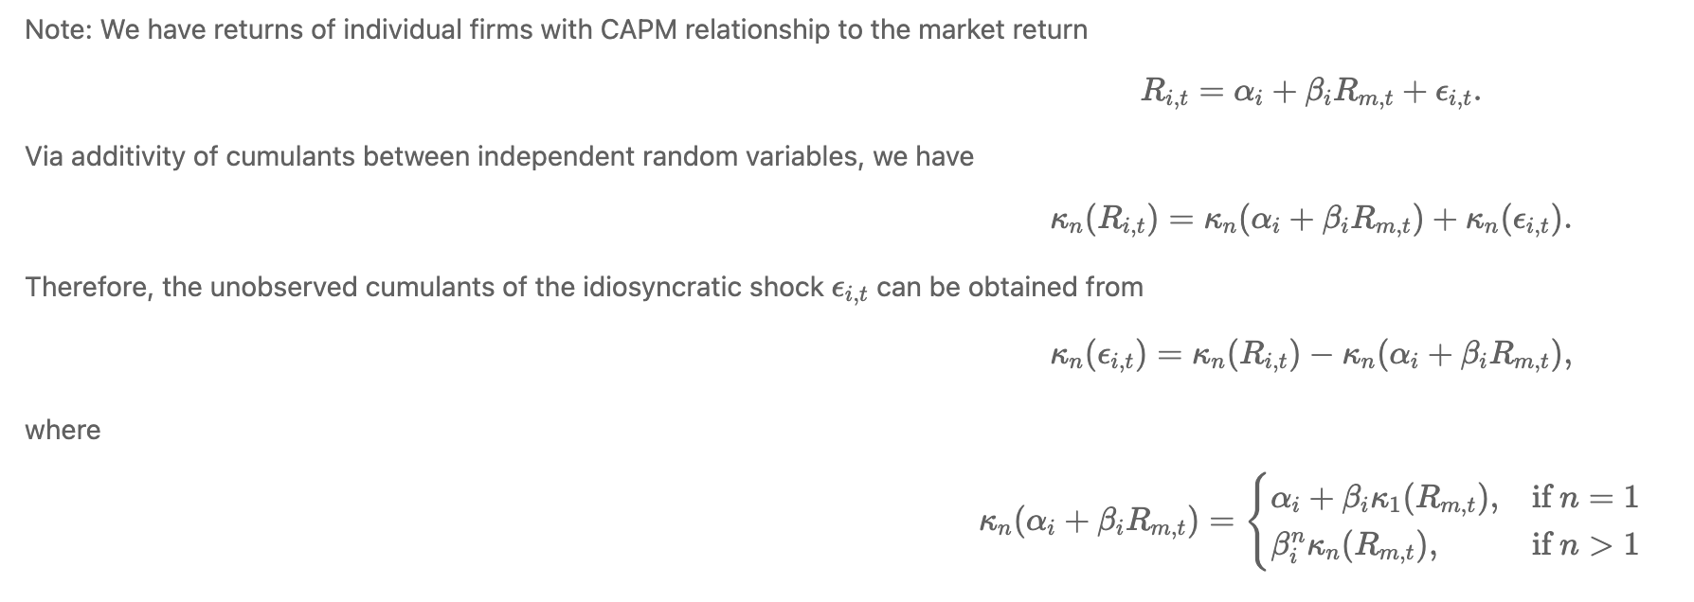
Task 4
Second central moment (variance) is equal to second cumulant of distribution
n-th cumulant (n=2: variance)
Systematic
Idiosyncratic
Idiosyncratic variance
We do not know alpha. Luckily,
we are looking at the second cumulant (n=2) and only need to know GS beta to compute systematic risk.
systematic variance
Market (SPX) variance
Firm implied beta

Slide 9
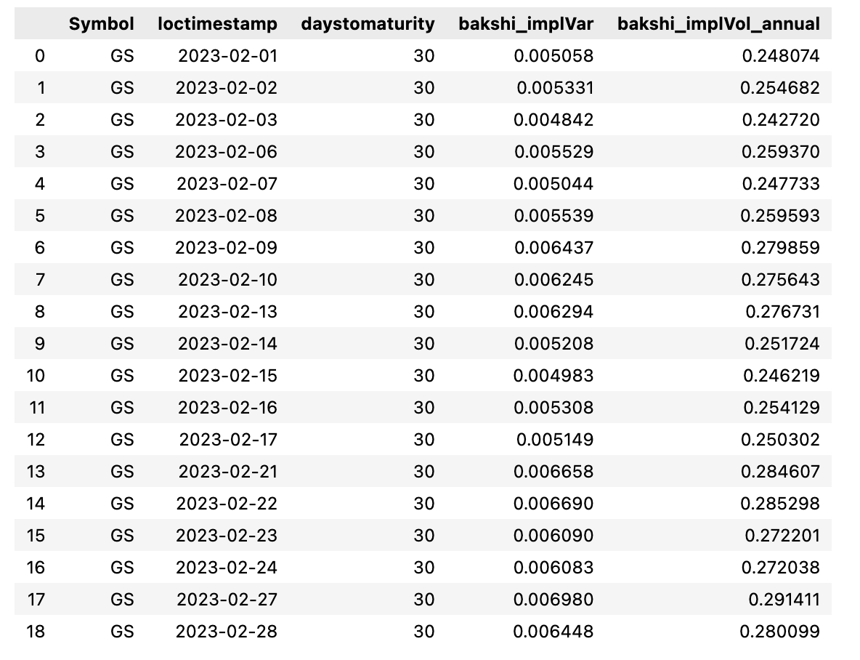
Task 4
Repeat task as already done for SPX to obtain GS implied variance

Slide 10
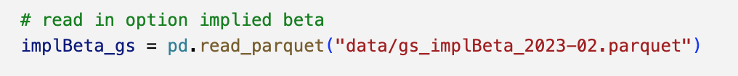
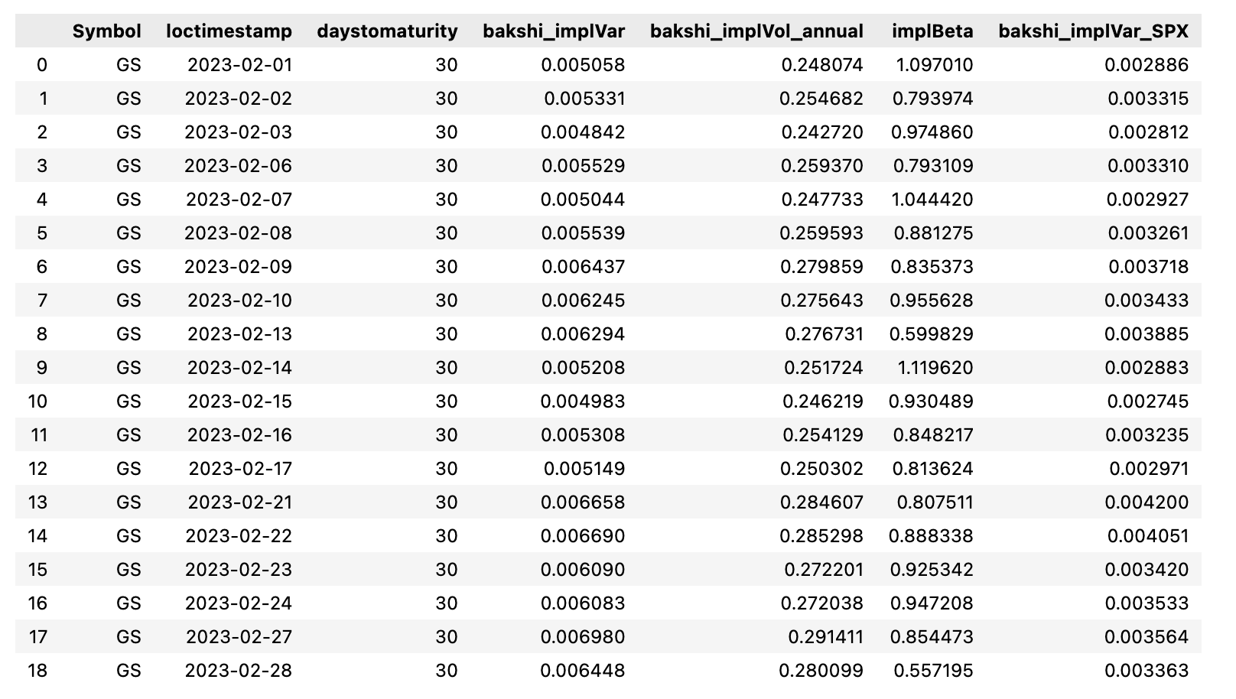
Task 4
We load in (pre-computed) option implied betas, estimated from the realized P return correlation between SPX and GS.

Slide 11
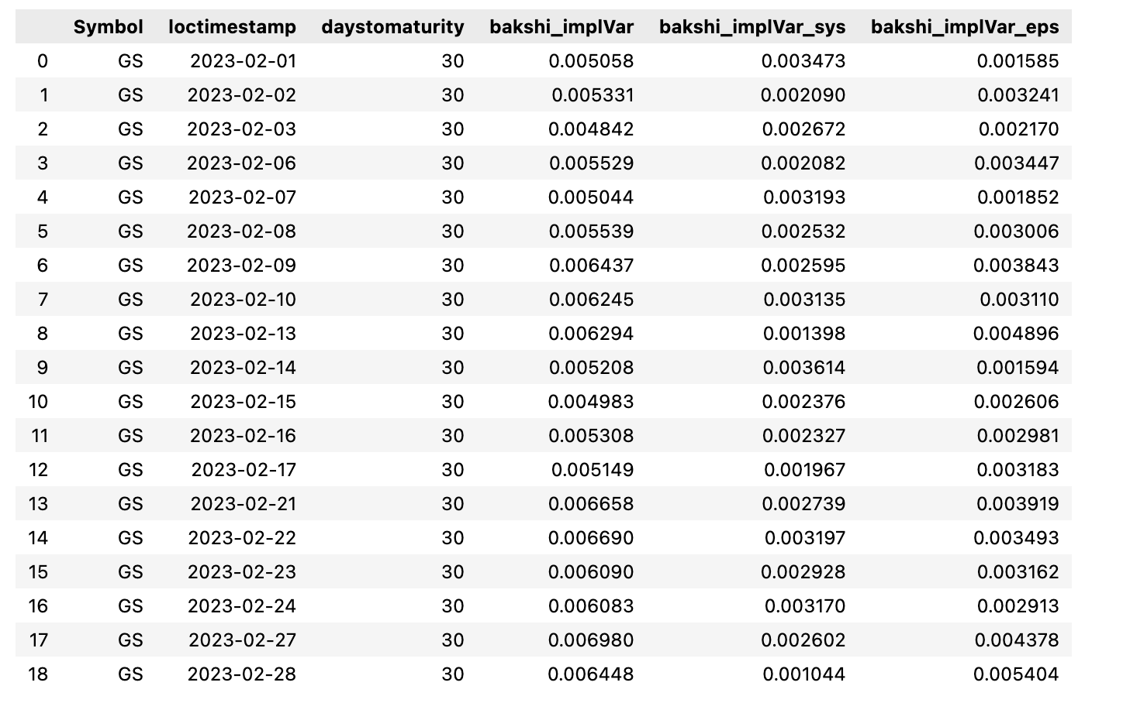
Task 4

Slide 12
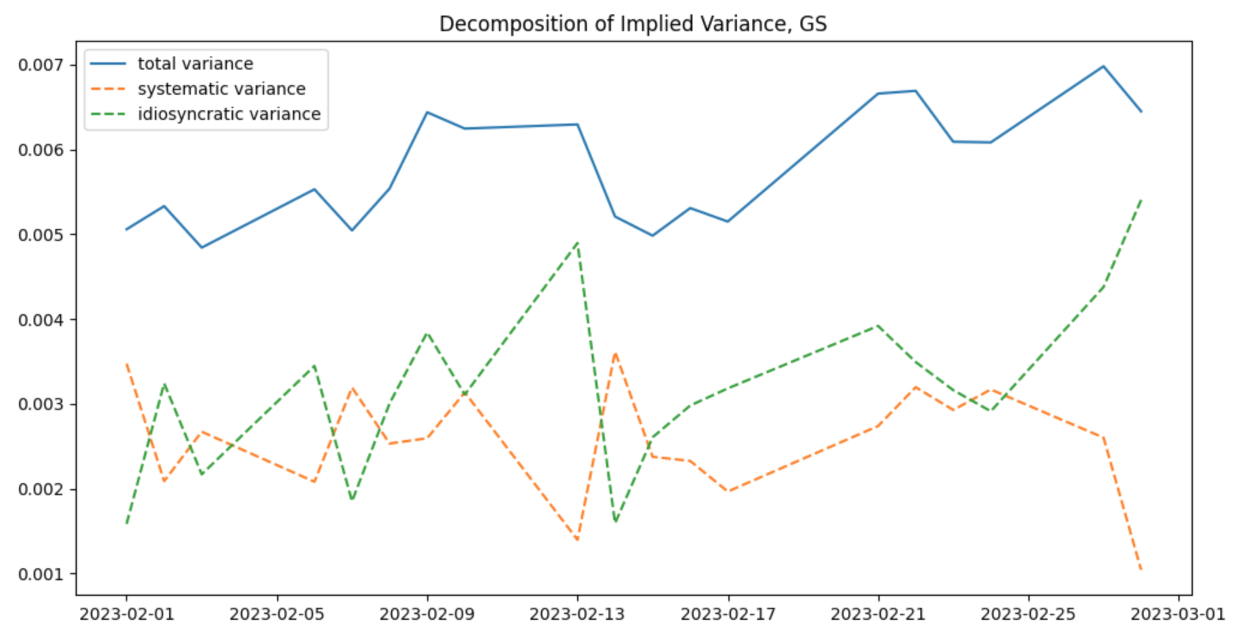
Task 4
Interpretation of results: Roughly half of risk is idiosyncratic (can be diversified)

Slide 13
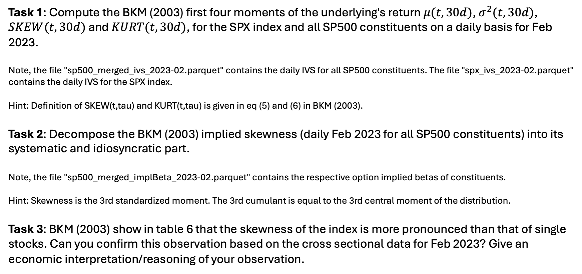
Homework
Task 1: Compute the BKM (2003) first four moments of the underlying's return $μ(t,30d)$, $σ^{2}(t,30d)$, $SKEW(t,30d)$ and $KURT(t,30d)$, for the SPX index and all SP500 constituents on a daily basis for Feb 2023.
Note, the file "sp500_merged_ivs_2023-02.parquet" contains the daily IVS for all SP500 constituents. The file "spx_ivs_2023-02.parquet" contains the daily IVS for the SPX index.
Hint: Definition of SKEW(t,tau) and KURT(t,tau) is given in eq (5) and (6) in BKM (2003).
Task 2: Decompose the BKM (2003) implied skewness (daily Feb 2023 for all SP500 constituents) into its systematic and idiosyncratic part.
Note, the file "sp500_merged_implBeta_2023-02.parquet" contains the respective option implied betas of constituents.
Hint: Skewness is the 3rd standardized moment. The 3rd cumulant is equal to the 3rd central moment of the distribution.
Task 3: BKM (2003) show in table 6 that the skewness of the index is more pronounced than that of single stocks. Can you confirm this observation based on the cross sectional data for Feb 2023? Give an economic interpretation/reasoning of your observation.

